Slide 1

School Billing System
INS2020 - 05
Programming 1 – C Language
Lecturer: Mr. Kim Dinh Thai

Slide 2
Group 5
1. Trần Châu Nhi – 21070679
2. Doãn Văn An – 21070236
3. Nguyễn Anh Quý – 20070972
4. Hoàng Thị Yến – 20071005
5. Nguyễn Hoàng Lan - 20070736

Slide 3
Table of Contents
01
02
03
04
Introduction
Module
Limitation and solution
Conclusion

Slide 4
01
Introduction

Slide 5
Introduction
- Calculate fees and salaries for students and teachers.
- C programming language.
- File Handling and data structures.
- Helping users calculate bills easier.

Slide 6
02. Module

Slide 7
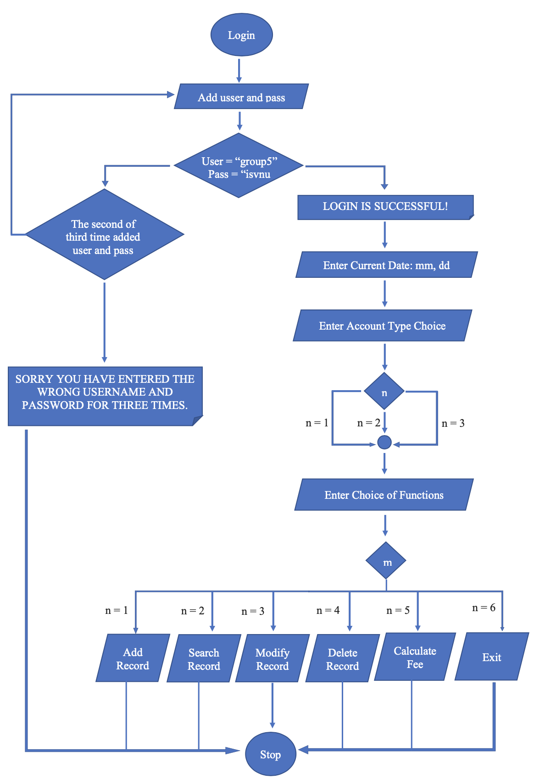
Overall flowcharts for algorithms

Slide 8
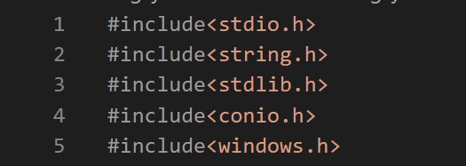
Module 1- Header

Slide 9
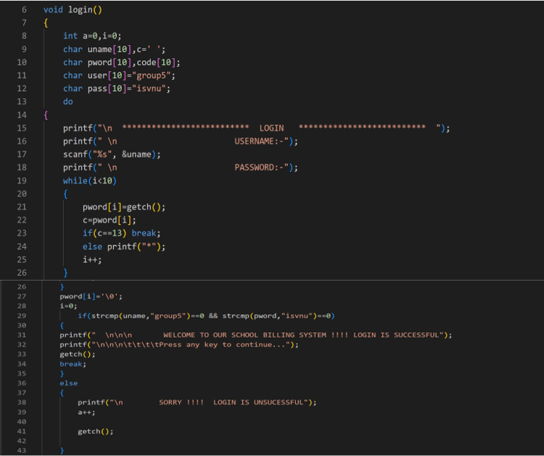
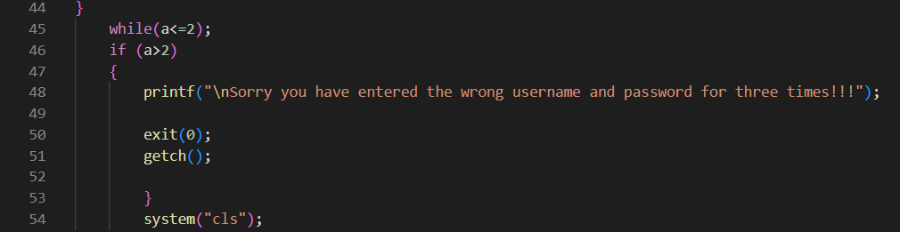
Module 2- Function login
- Use char styles to declare usernames and passwords.
- Use a do-while loop to convert Password into " * “.
- Strcmp to compare two strings of user characters and pass.
Break to end the program.
If you enter the wrong password 3 times, the system will automatically close .

Slide 10
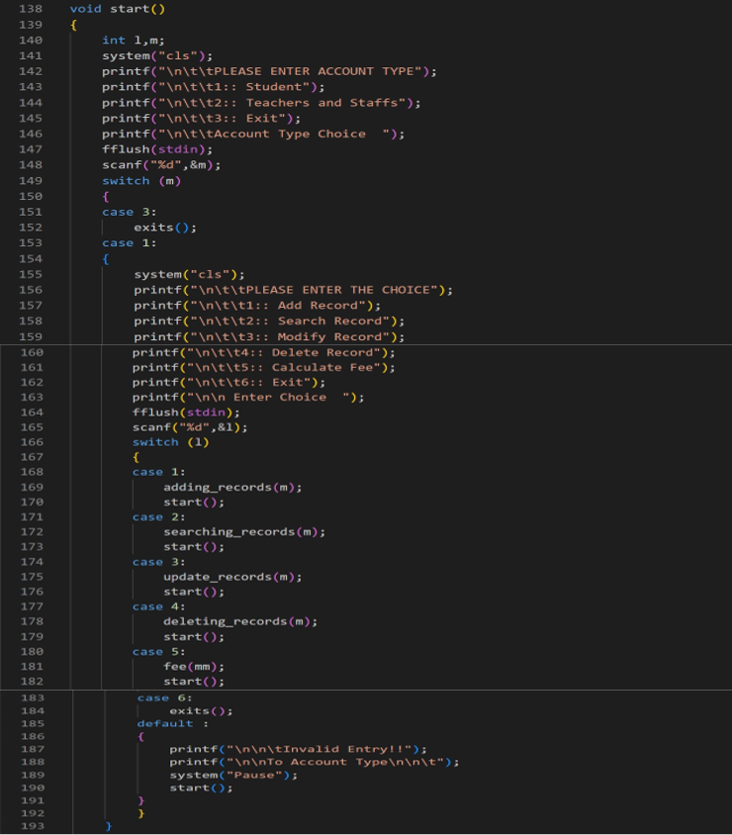
Module 3- start Window
-Fflush(stdin) so that the cursor can point in the right place.
- Use switch-case to compare values.
- Default for handling exception cases.

Slide 11
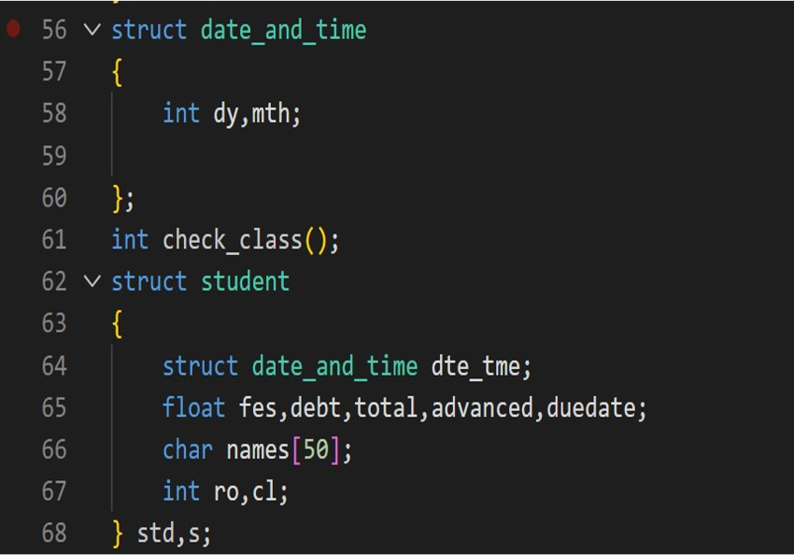
Module 4 – Declare struct and function
- Declare date_and_time.
- Declare struct student.

Slide 12
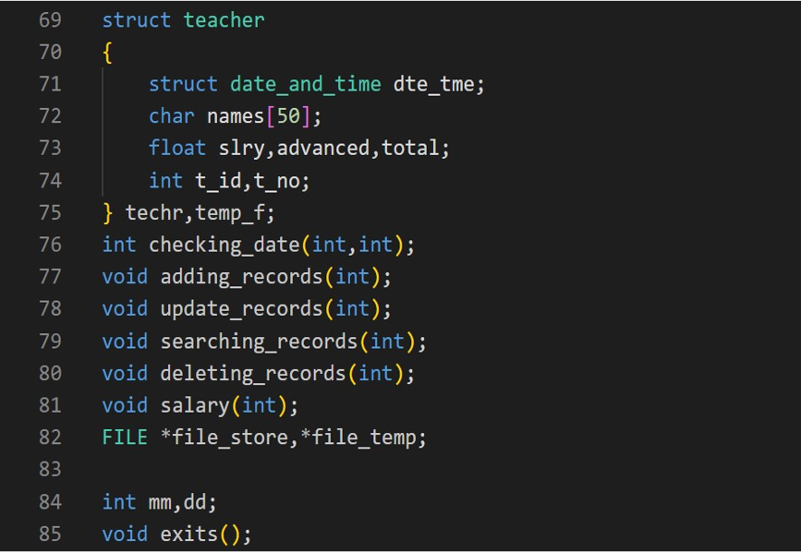
Module 5 – Declare struct and function
- Declare teacher.
- Declare function.

Slide 13
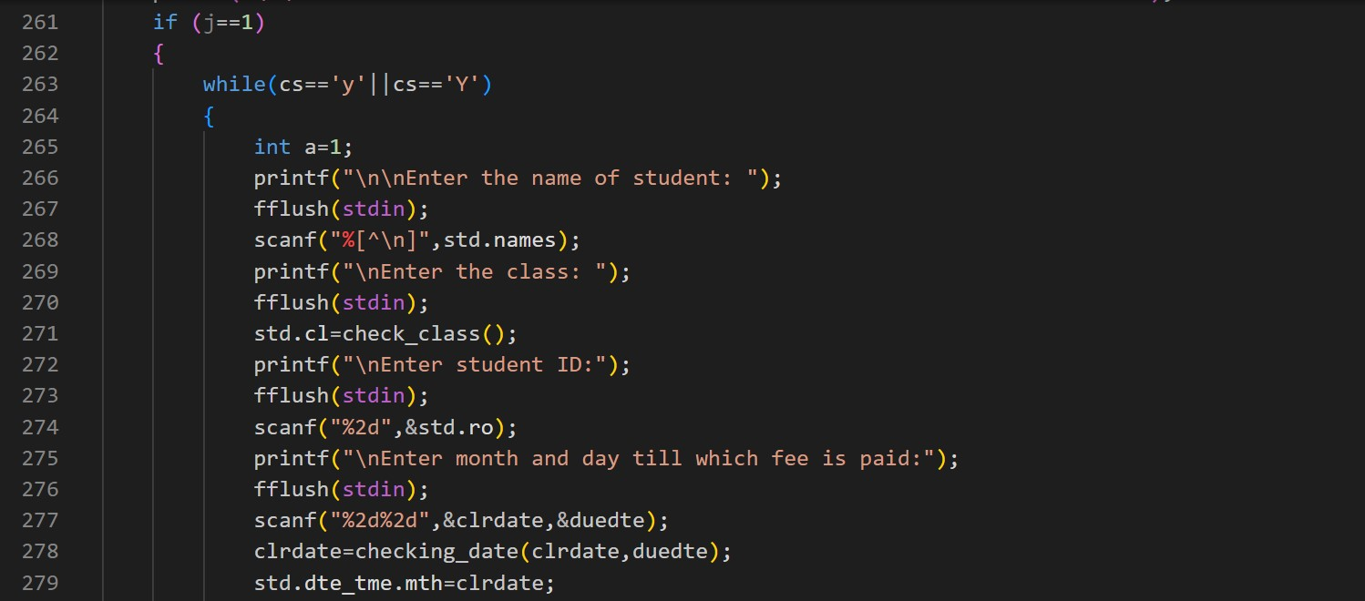
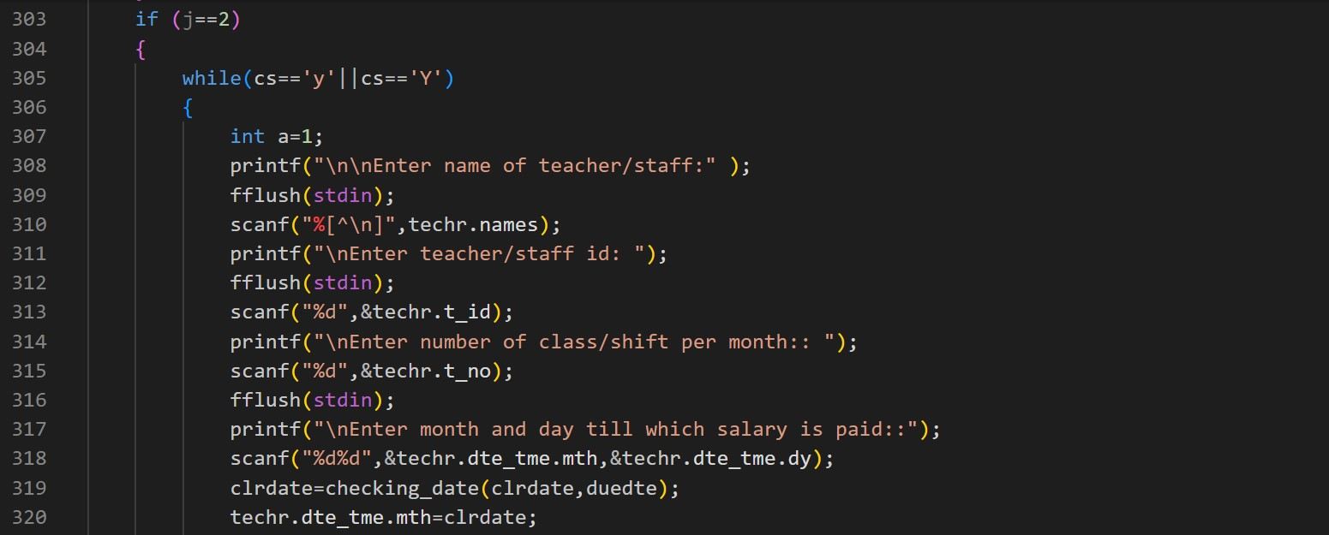
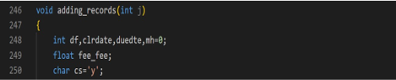
Module 6- Add record
- fee_fee: calculating of fee of different class.
- Clrdate = month till which is cleared.
- Clrdate=checking_date: check the date entered.
- While loop => Leave the information in the add record. - “j” is for the selection of account type.

Slide 14
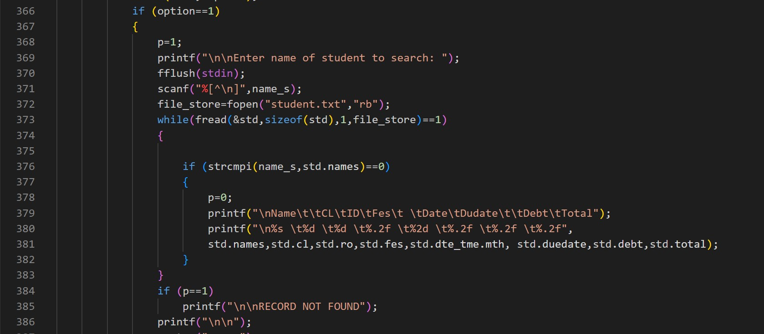
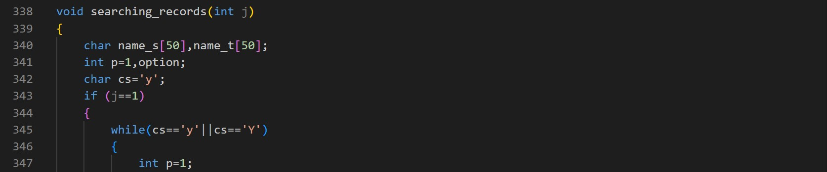
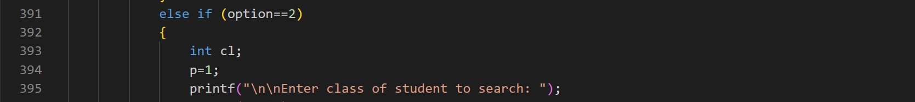
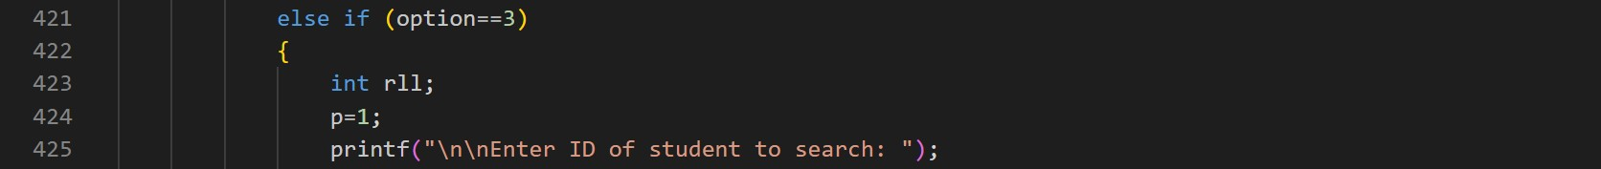
Module 7- Search record
Use the loop “while”.
- Use if - else in the options.
Having 4 option:
+) Option 1: search name.
+) Option 2: search class.
+) Option 3: search ID.
+) Option 4: exit and pause the system.

Slide 15
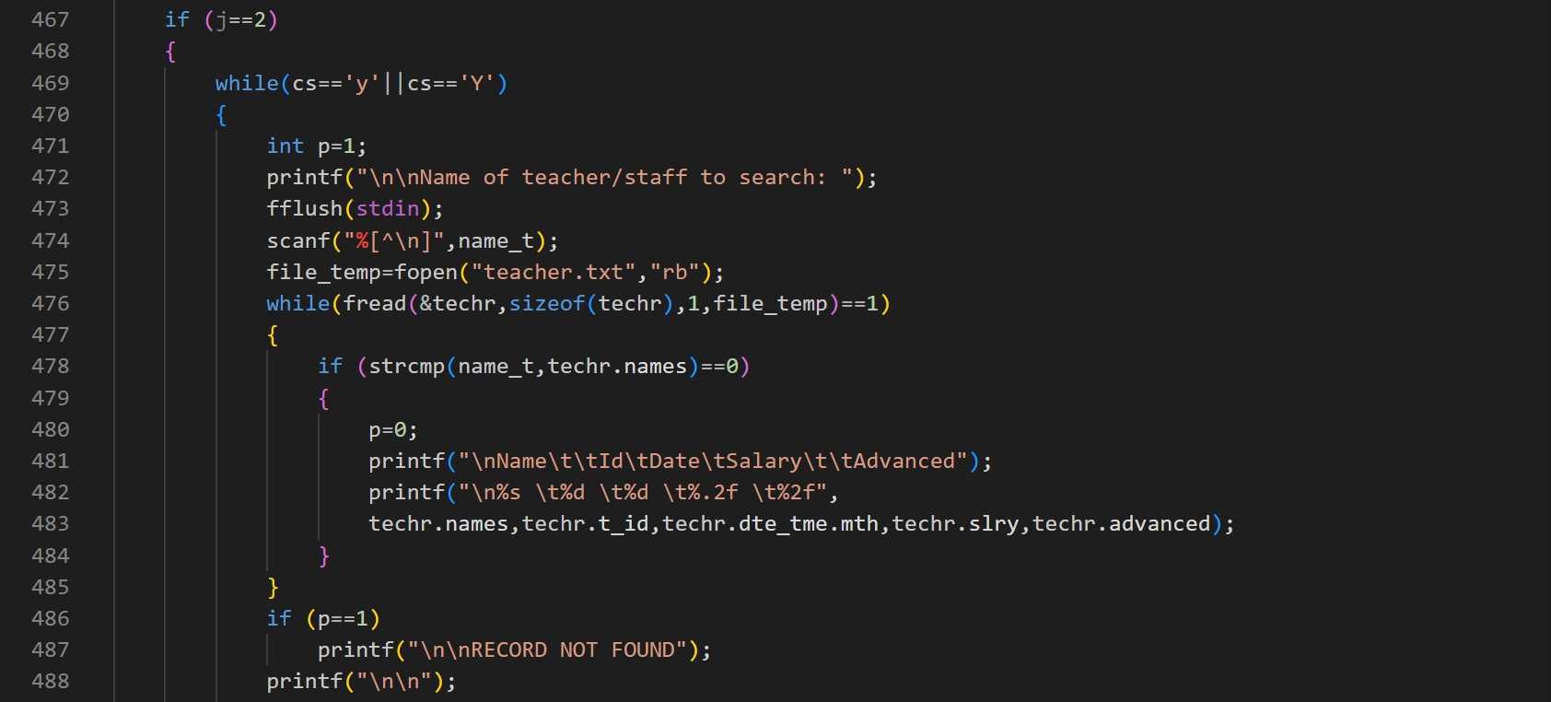
Module 7- Search record
- Use the while loop => Read files.
- Strcmp: Compare names in techr.names.

Slide 16
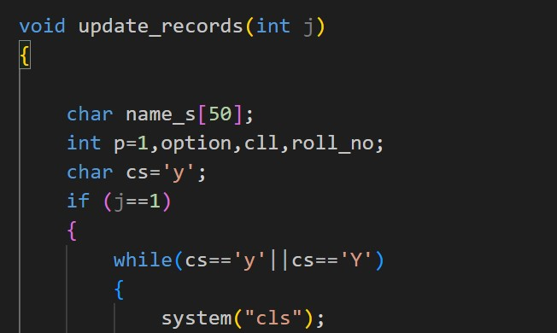
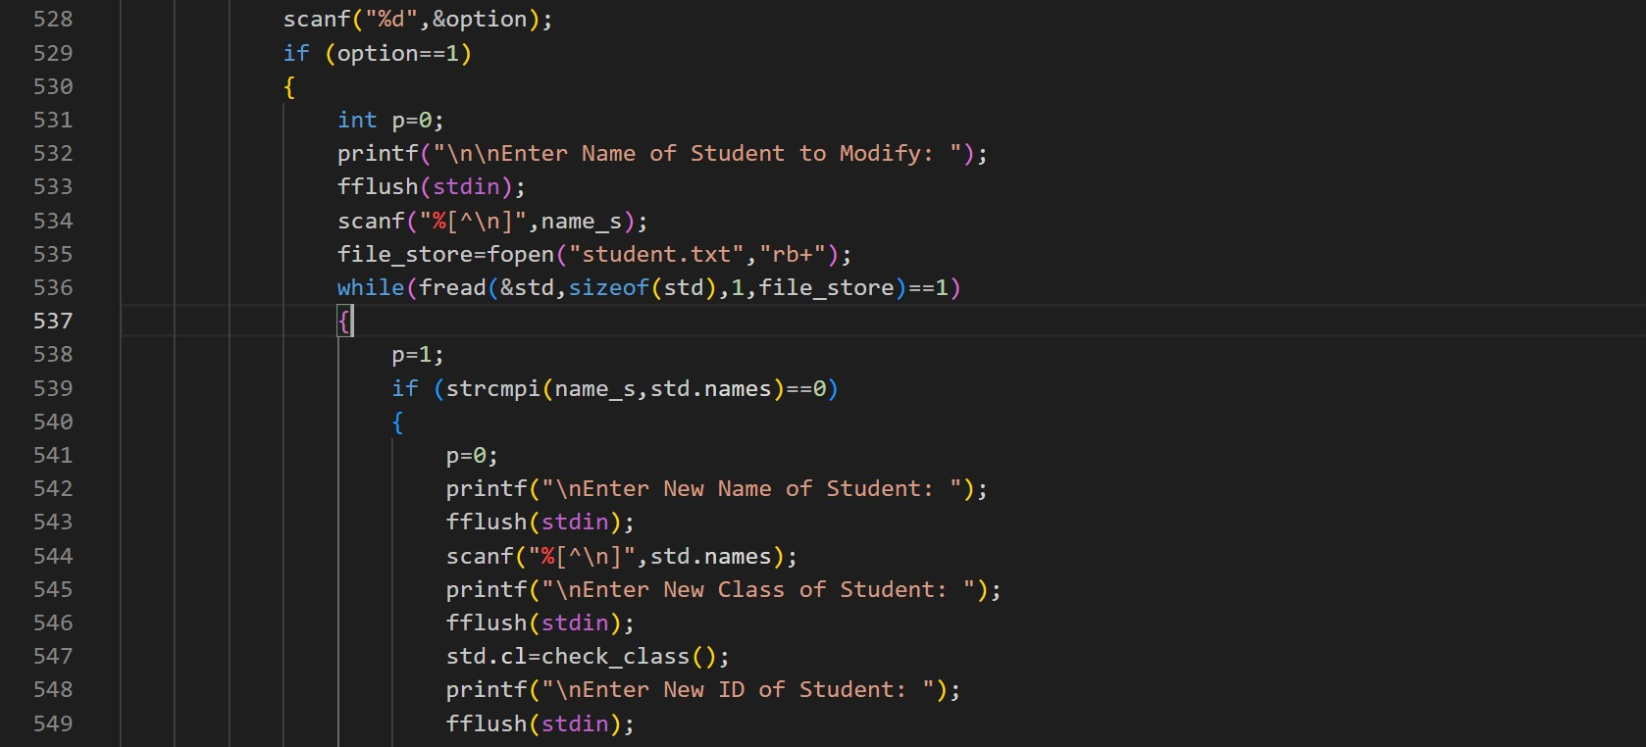
Module 8- update record
Declare variable
- Scanf: enters options.
- Option 1: updates by name.

Slide 17
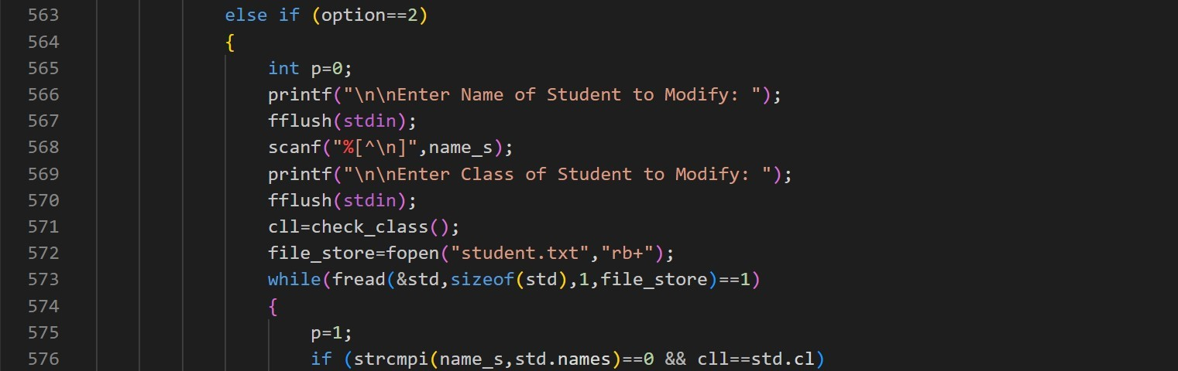
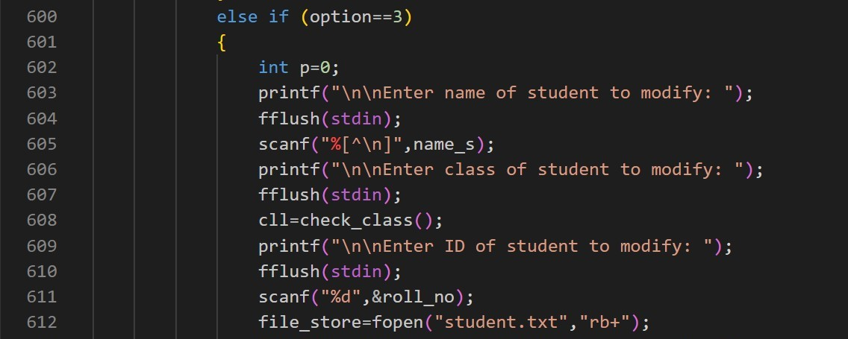
Module 8- update record
- Option 2: Updates name and class.
- Option 2: Updates name, class, and ID.

Slide 18
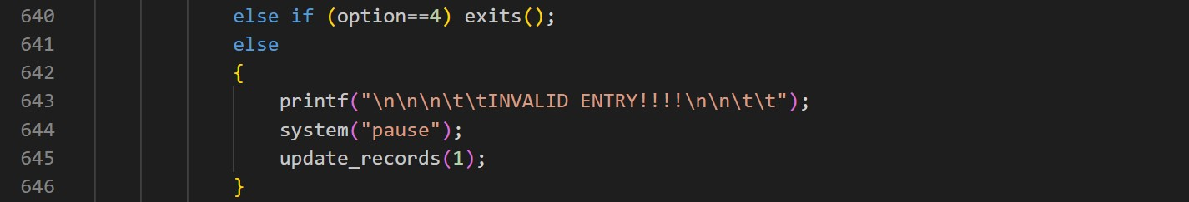
Module 8- update record
- Option 4: Exit and pause the system.

Slide 19
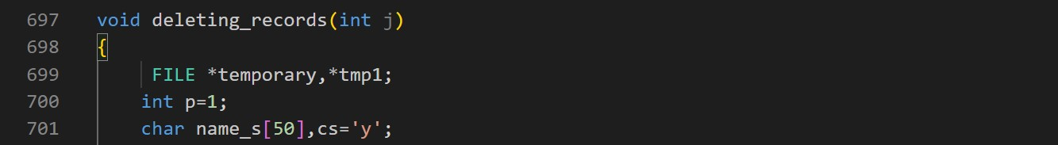
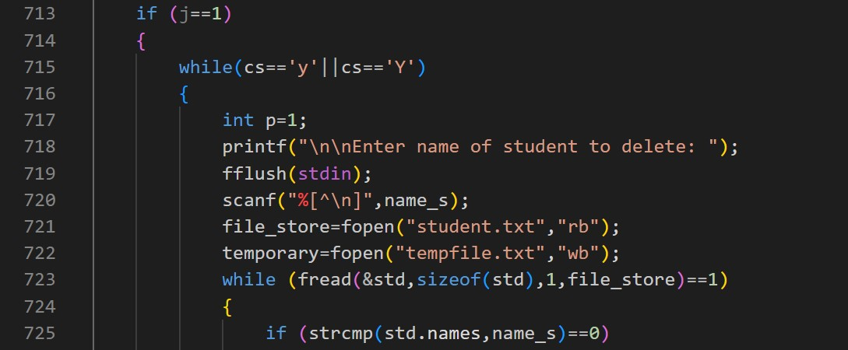
Module 9- Delete record
Declare the information you want to delete
- For student.

Slide 20
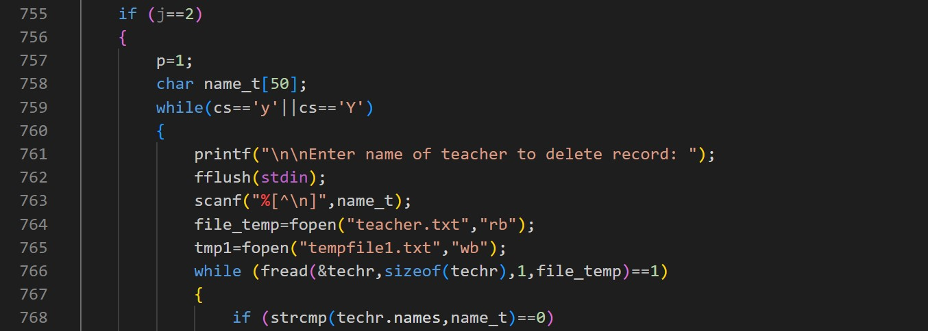
Module 9- Delete record
For teacher

Slide 21
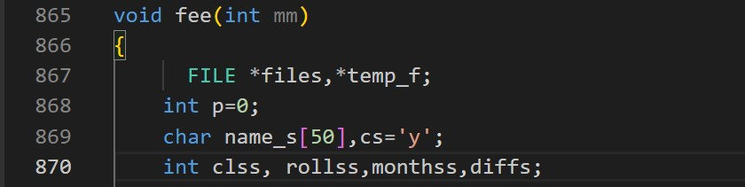
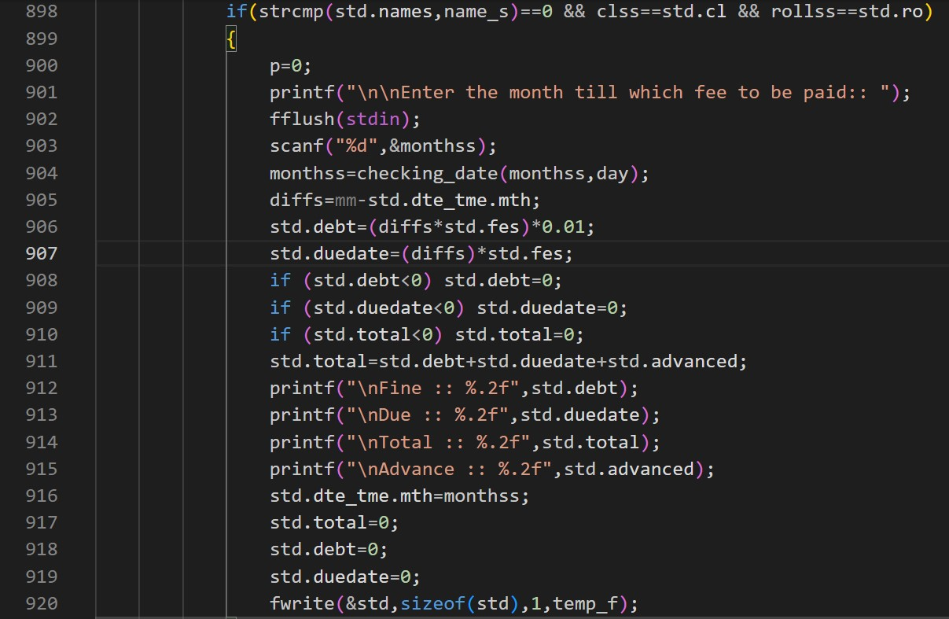
Module 10- Calculate fee
Declare variable
- df = mm-std.dte_tme.mth
+) mm: month at the current time.
+) std.dte_tme.mth: month at the time the fee is paid.
- If df=1 then the sum will be calculated.
std.total=std.fes;
std.debt=0
- If df#1
std.total = std.debt+std.duedate

Slide 22
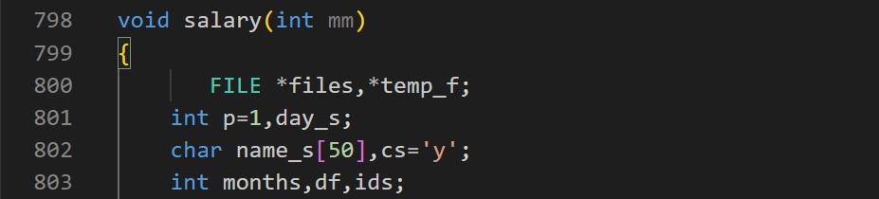
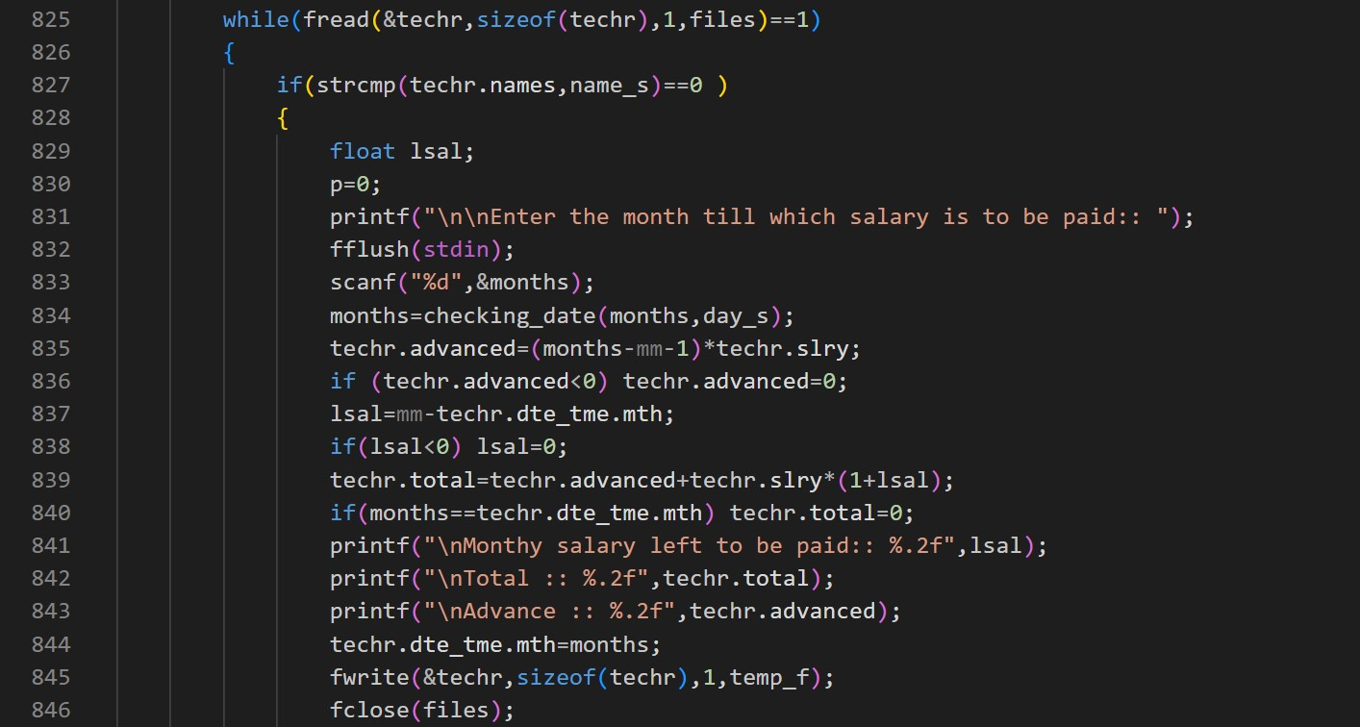
Module 11- calculate salary
Declare variable
Clardate=checking_date is to check the date entered.
Tech_no: number of classes the. teacher teachers
Mm: month at current time.
If techr.advanced=0
then techr.total=techr.slry.

Slide 23
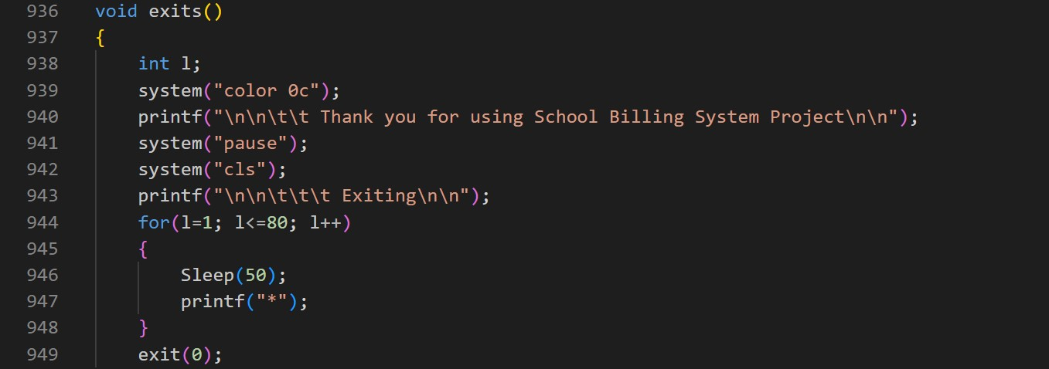
Module 12- Function exit
Sleep(50) after printing one “.” another comes after 0.05 seconds.
System (“cls”) clears the screen.

Slide 24
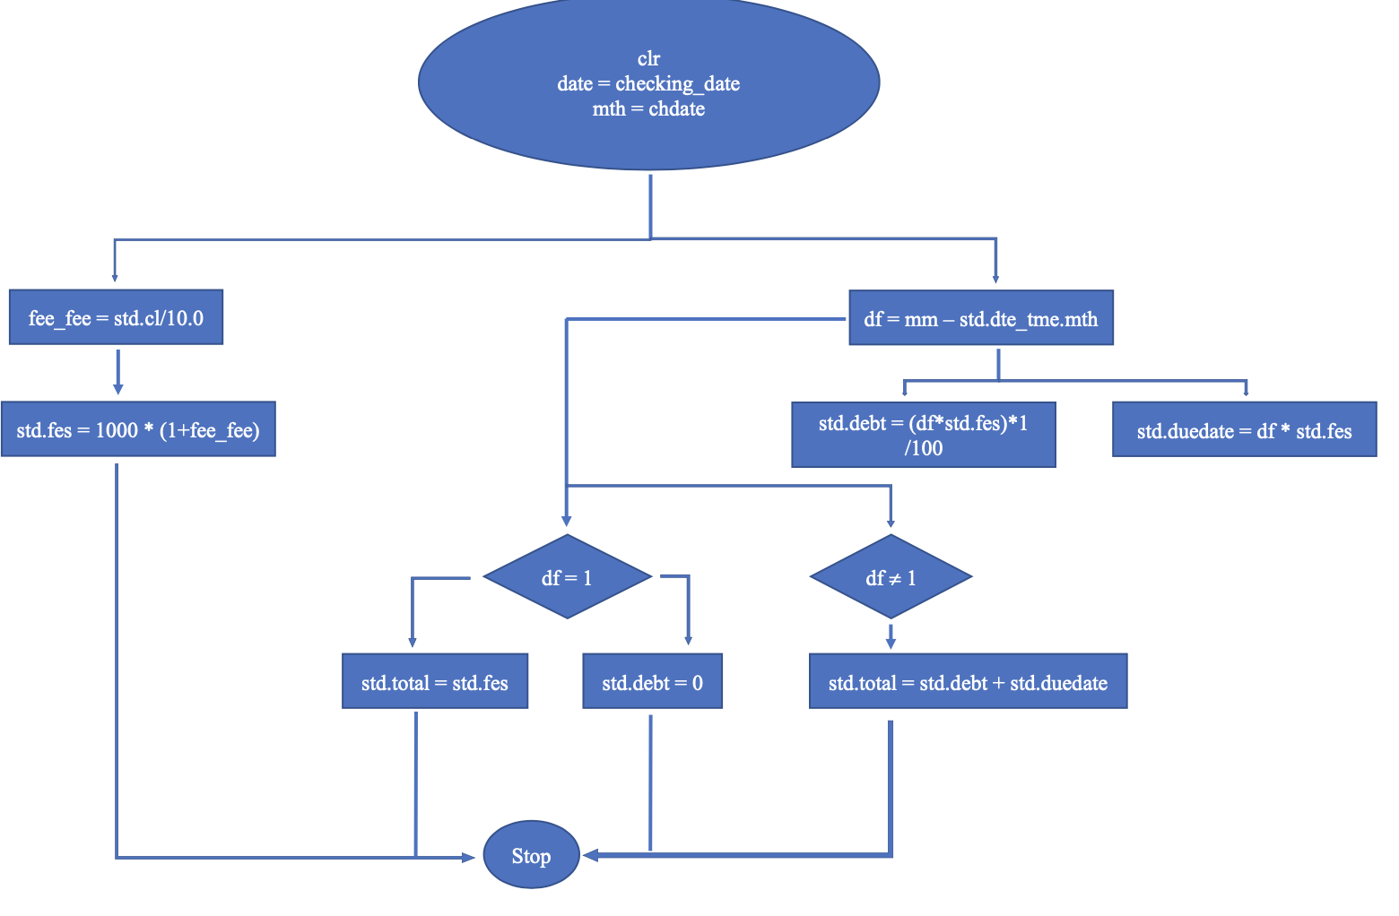
Module 13- Algorithm flowchart
For student’s fee

Slide 25
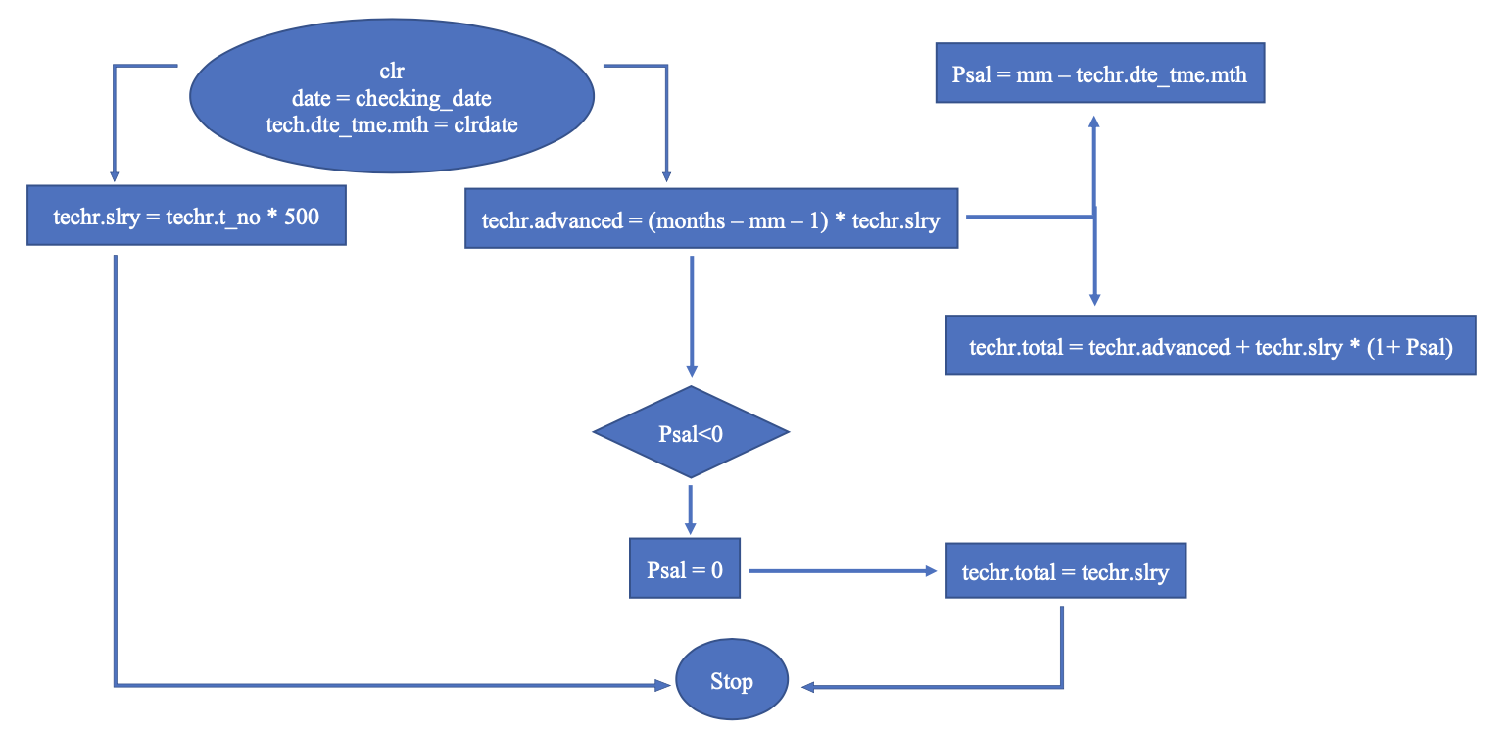
Module 13- Algorithm flowchart
For teacher’s or staff’s salary

Slide 26
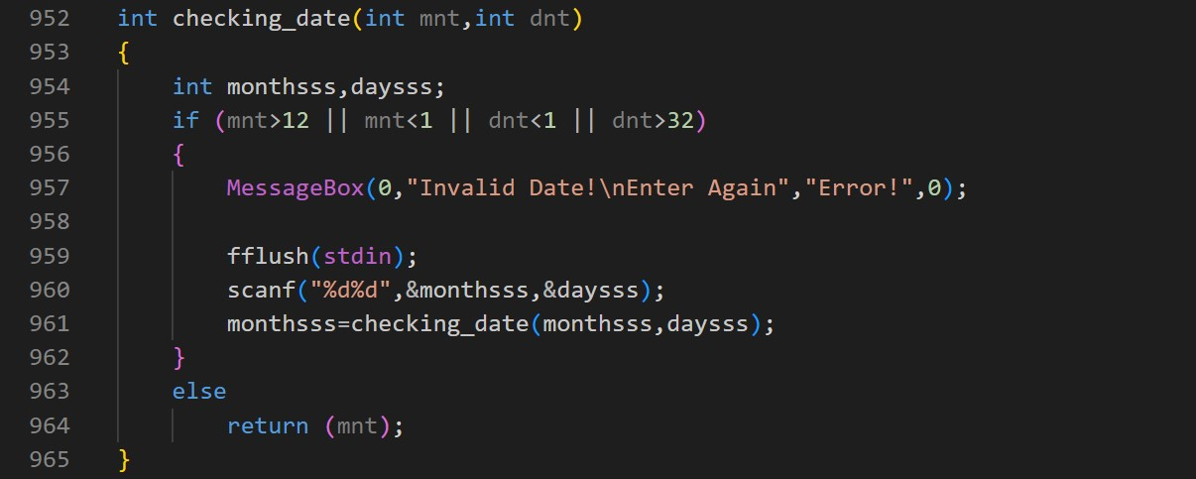

Module 12-check the date and time

Slide 27
03. Limitation and Solution

Slide 28

Limitation
The Billing system for students have some limitation
Limitation concerns the billing system for lectures or staff

Slide 29
Solution
$20K
Hypothetically our group Practically in future projects
10
45K

Slide 30
04. Conclusion

Slide 31
Conclusion
Inserting, searching, removing, and modifying information of each student, teacher, or staff.
The main function is the calculation which will make it easier to calculate fees and lecturer and staffs’ salaries.
Before applying please consider the limitations.
Research and innovation are needed to improve.

Slide 32

Thanks

